Slide 1

Cyber Security Threat Model
Data Explorer – Open Delta
October 2024

Slide 2
Executive Summary
Inherent Risk
The system is internet facing, is using new technology, the inherent risk is considered Critical as the highest classification of data that it processes is highly sensitive.
CRITICAL
Control Design
The system design includes all expected controls to mitigated the key threats identified.
SUFFICIENT
Conclusion
The system design is considered sufficiently secure without the need for any additional controls. This system can proceed to the build stage.
Due to the new technology, bespoke security and internet accessibility, a Secure Design Review and Penetration Test must be undertaken on the system before go live.
PROCEED
TO BUILD
Cyber Security Threat Model Sensitive

Slide 3
Threat Modelling Details
System Details
Name
Data Explorer – Open Delta
Purpose
Open Delta sharing allows the sharing of data with a 3rd party.
System Summary
The Open Delta solution is a feature that can be turned on in Databricks to allow sharing of data with third parties, whether they use Databricks or not. It uses a protocol to make data available over HTTPS. This solution is particularly useful for enabling access to People First customer data from various tools, including PowerBI.
Risk Assessment
Data Classification
High Risk
The data being shared is likely confidential or restricted as it involves customer-specific production reporting schemas with row-level filtering for multi-tenant customers.
Internet Facing
High Risk
Delta Sharing operates over HTTPS, making it internet-facing when sharing data with external customers.
Security Configuration
High Risk
Managed via a bearer token, the system enforces authentication for each customer, allowing access to only the data they are authorized to view.
New Technology
High Risk
Delta Sharing Protocol: This is a relatively new protocol designed for sharing data externally from Databricks via an open-source platform, and it introduces specific management and security challenges.
Exercise Details
Date Performed
September 2024
Threat Modeler(s)
David Biayna Neal – Security Consultant
Threat Modelee(s)
Andy Skinner, Analytics Solutions Architect
Cyber Security Threat Model Sensitive

Slide 4

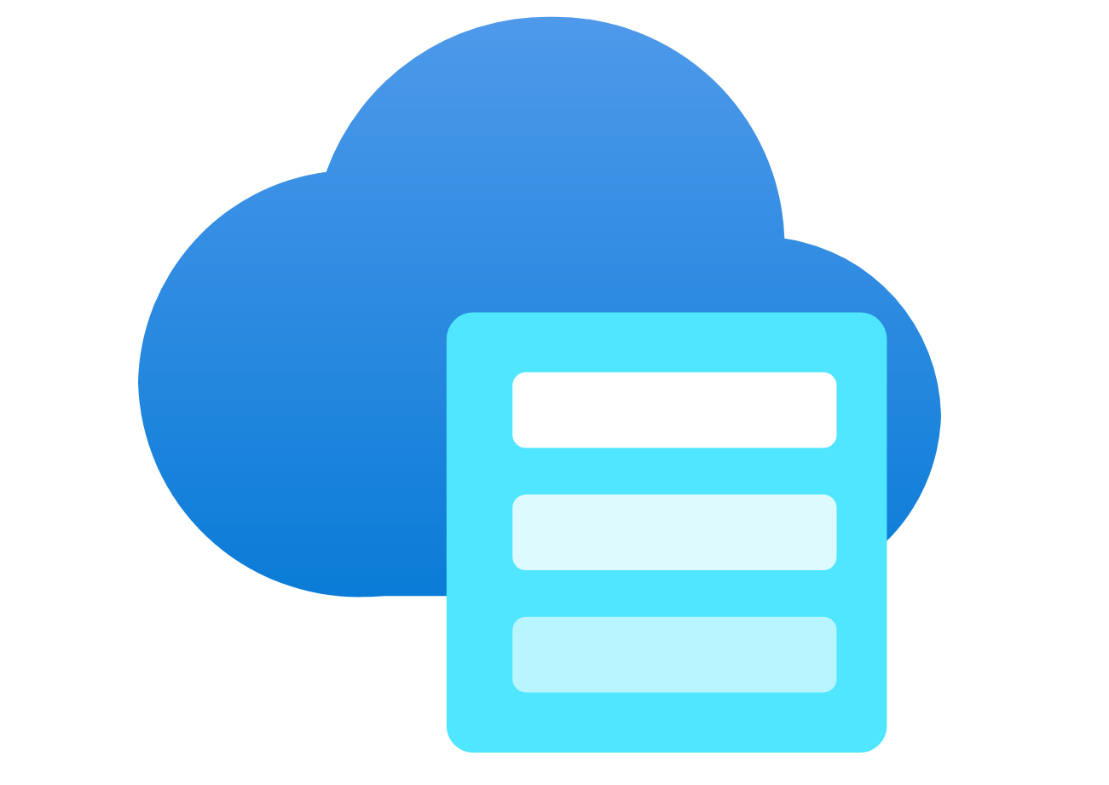






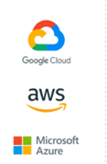

Threat Model
Azure
Asset Ref. | Asset Title
A01 | Customer Data
Data Lake / Datasets
A01
Data collection
Storage Account /Host
Threat Ref. | Threat Title
T01 | Compromised customer able to access other customer's data
T02 | Malicious actor attempts to manipulate authentication mechanism.
T03 | Malicious actor intercepts the token
1.Recipient assigned to share.
6.recipient uses the pre-signed URLs to download the data
5.Server generates short-lived pre-signed URLs
T02
4.The recipient uses the config file to authenticate with the Delta Sharing server.
2.Signup link sent to recipient
External
3.Recipient uses link to download configuration file with a bearer token and access URL.
T03
T01
Customer
Cyber Security Threat Model Sensitive

Slide 5
Mitigating Controls
Threat Ref | Description | Component | Asset Ref. | Required Control | Control Effectiveness | Threat Mitigation
T01 | Compromised customer able to access other customer's date |  | A01 | Implement access controls, establish strict data sharing policies, and enable audit logs for monitoring access.
T02 | Malicious actor attempts to manipulate authentication mechanism. |  |  | Implement strict bearer token management with expiration policies and enforce IP restrictions to limit access.
T03 | Malicious actor intercepts the token |  | A01 | Delta Sharing operates over HTTPS.
​

